Slide 1
Perry Christensen
Personal Brand: Communicating How You Add Value and Get Results

Slide 2
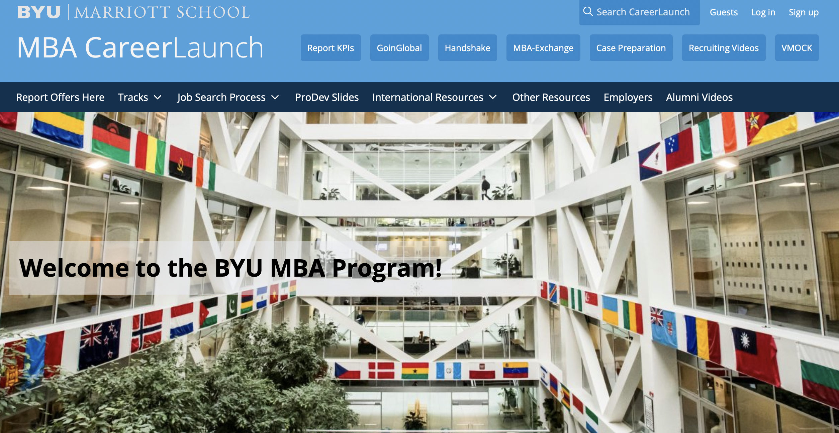
BYU MBA CareerLaunch Website: “One Stop Shopping”
https://mbacareerlaunch.byu.edu

Slide 3
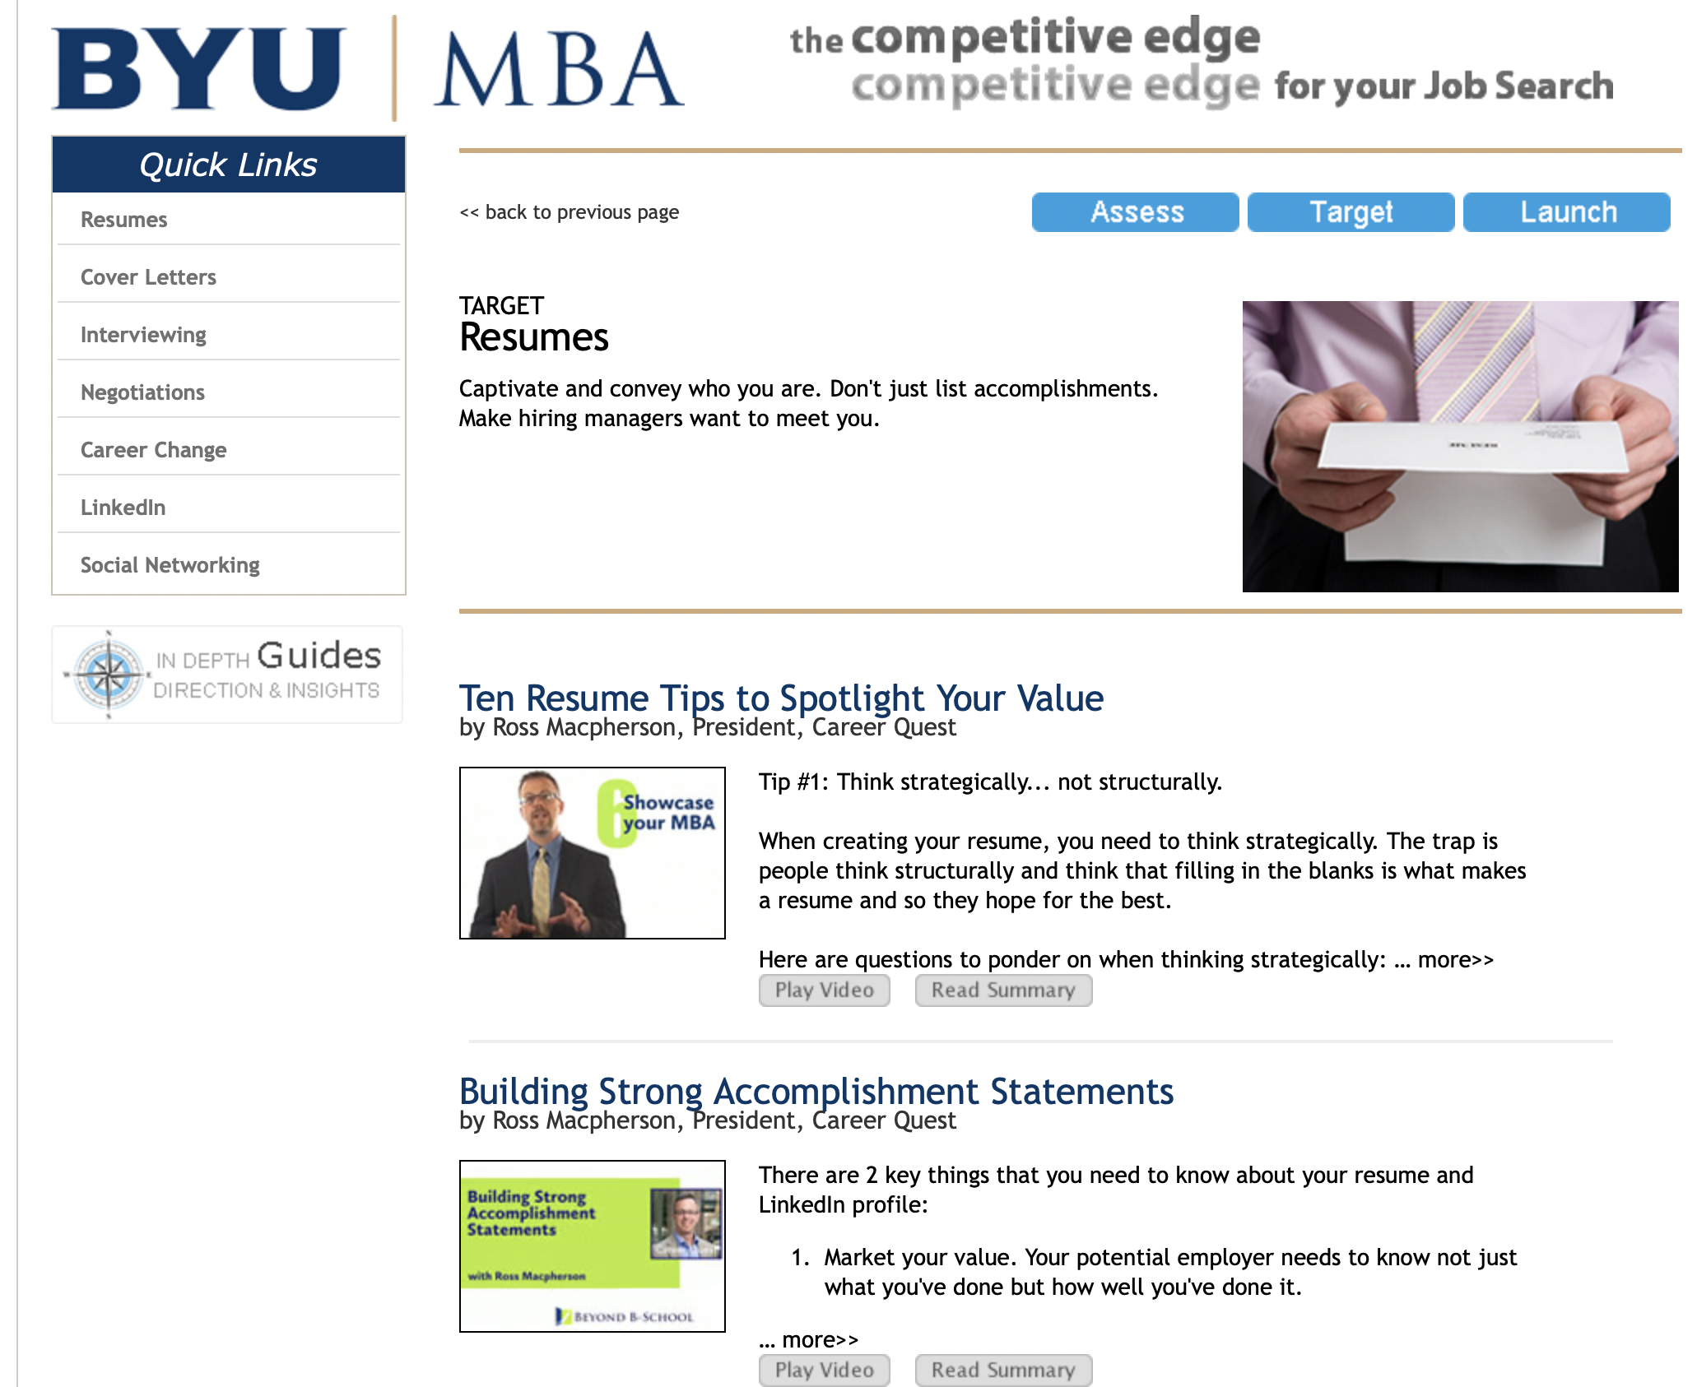

Slide 4
How Do I Add Value:
My Personal Brand

Slide 5
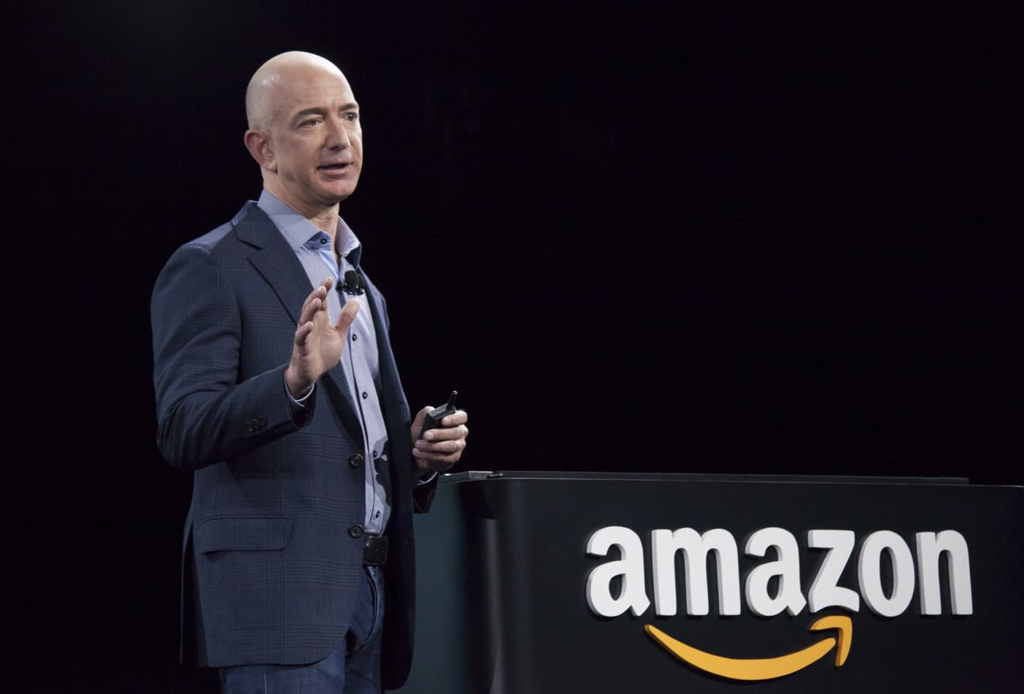
”Your brand is what other people say about you when you are not in the room.”
--Jeff Bezos,
Founder, executive chairman, and former president and CEO

Slide 6
Personal Brand:
What do I want in the “head” of the person interviewing me?

Slide 7
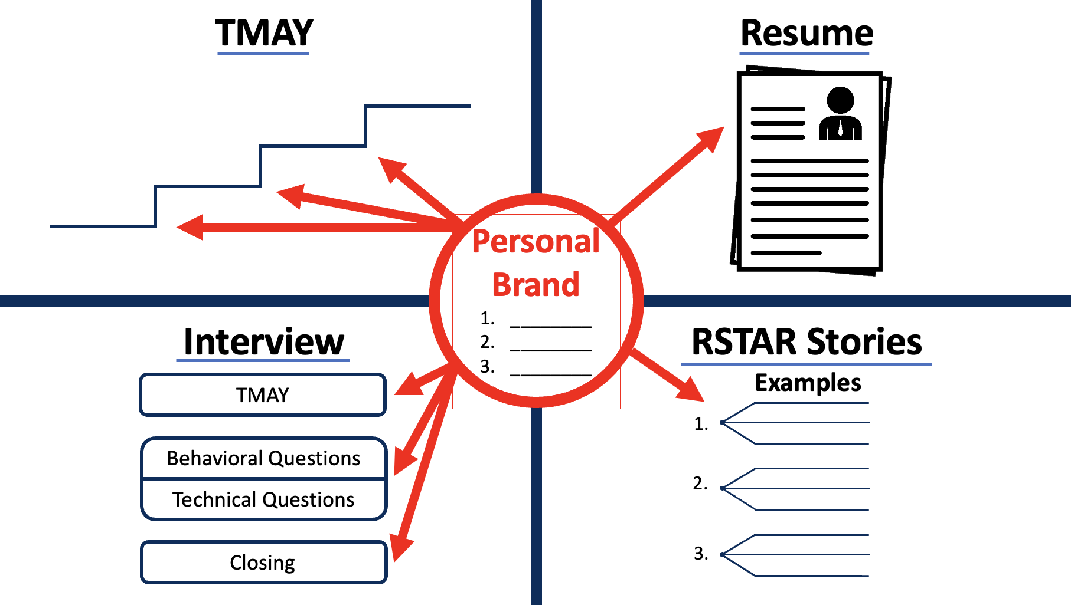

Slide 8

Questions to Identify Your Personal Brand
Tell me about a time when you were so excited
about your project/work that you did not want to stop?
Tell me about your biggest accomplishment?
What are your 3 biggest strengths?
What accomplishment are you most proud of? When did you make a difference in the company?
What would your best friend say is your best quality?

Slide 9
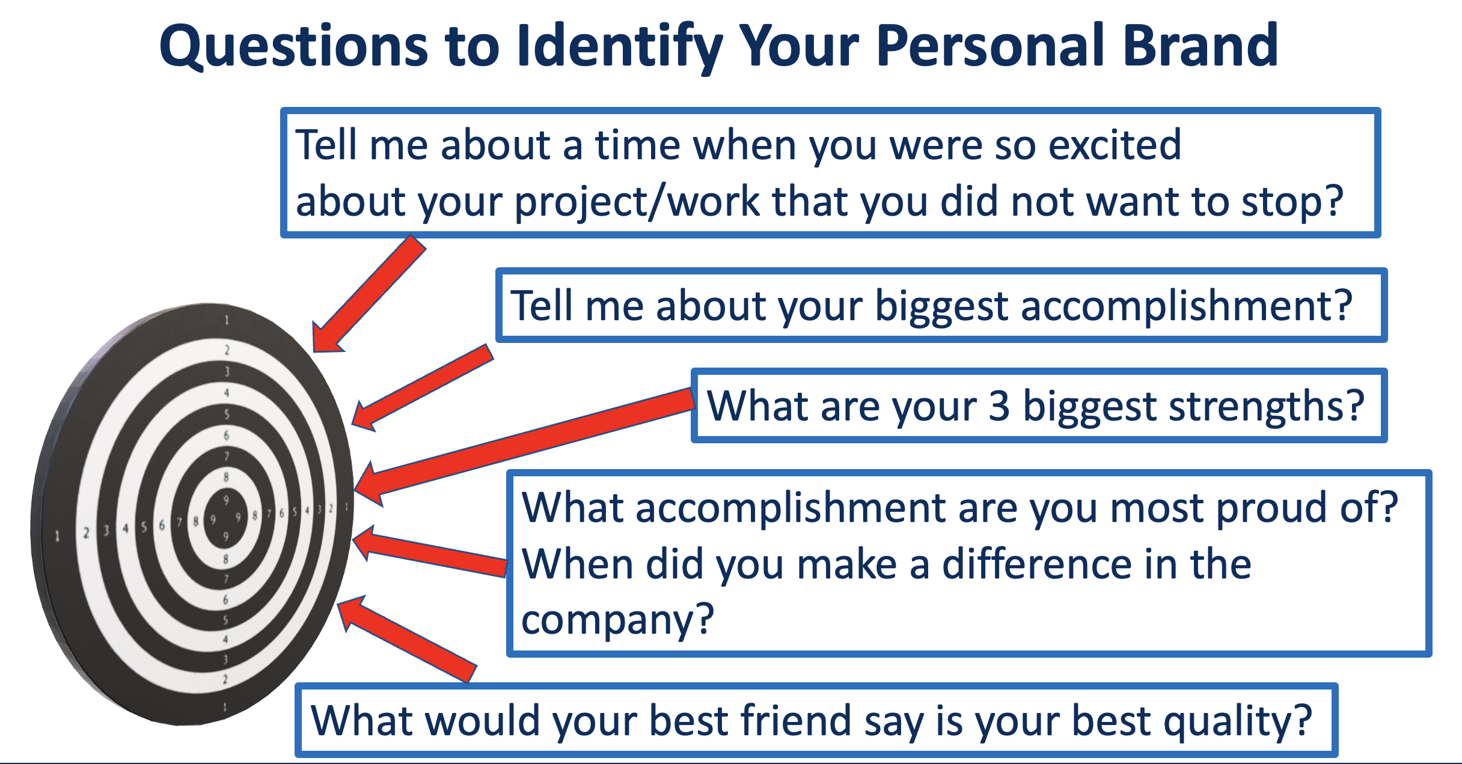
Exercise #1:
Personal Brand #1 | Personal Brand #2: | Personal Brand #3:

Slide 10
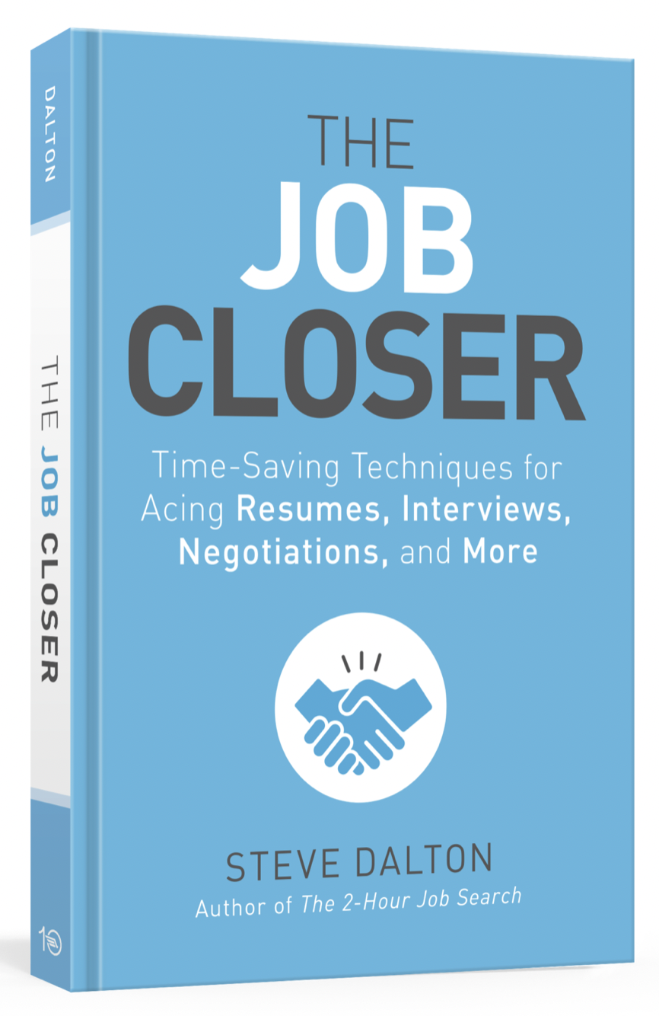
“The Job Closer”
Steve Dalton
Best Practices for Before, During and After the Interview
Tell Me About Yourself (TMAY):
  F--Favorite
  I--Insight
  T--Transition to next role

Slide 11



Tell Me About Yourself: Impact
GOAL: Your TMAY has 2-3 MEMORABLE, Impactful Moments
What do I want in the “head” of the person interviewing me?
How long after the pitch will they remember you?

Slide 12
“FIT” Framework
(Steve Dalton, Author of “The 2-Hour Job Search” and “The Job Closer”
F = Favorite Impact: Favorite aspect of your job
I = Insight: What you learned (through “thick or thin”)
T = Transition: How your “insight” set you up to transition to your next “favorite” role or job.

Slide 13
Memorable, Favorite Impact/Insights/Transitions
--Favorite Impact
--Insight
--Transition
--Favorite Impact
--Insight
--Transition
--Favorite Impact
--Insight
--Transition

Slide 14
Exercise #2:
FIT#3
Favorite: Insight: Transition:
FIT #2
Favorite: Insight: Transition:
FIT #1
Favorite: Insight: Transition:

Slide 15
Kate/Ben https://www.youtube.com/watch?v=QYRmcJUeGBo

Slide 16
Applying Personal Brand to the Resume

Slide 19
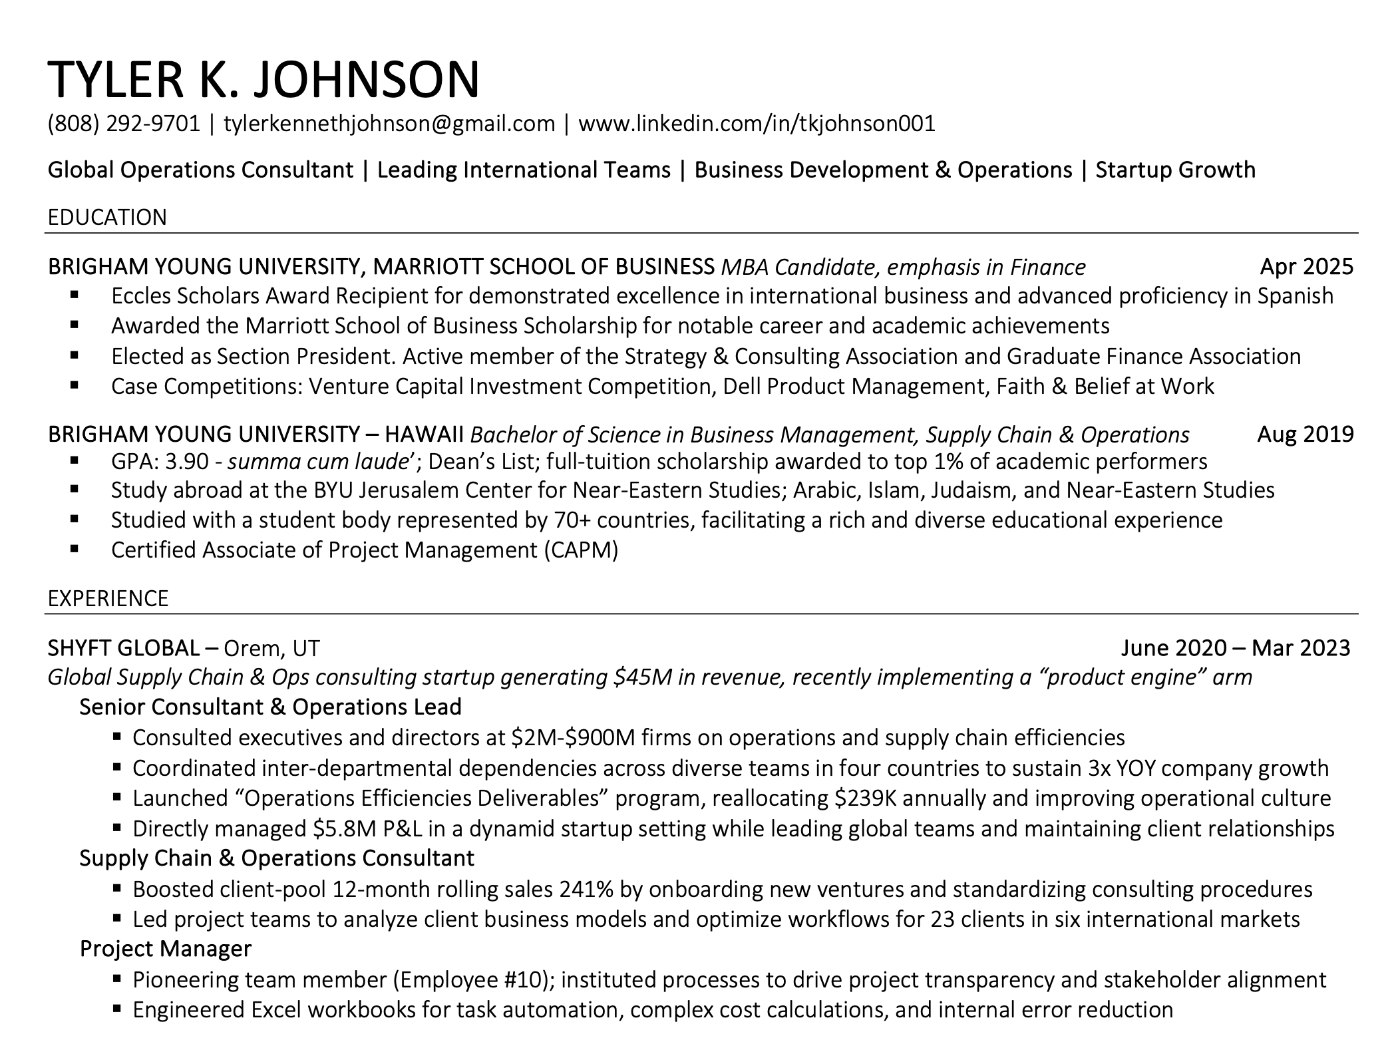

Slide 20
Applying Personal Brand to Your Interview

Slide 22
RSTAR Stories – Ace the Interview

Slide 23
A Few Behavioral Interview Questions
“Tell me about a time you were given an assignment with an impossible deadline.”
“Tell me about an example of your leadership or project management experience.”
“Describe a time in which you were able to use your analytical skills to solve a business problem.”
“Describe a time when you had to work with a difficult colleague.”

Slide 24
RSTAR
Result (10%): What did you accomplish?
Situation(10%): What was the problem to solve?
Task (20%): What did you need to do?
Action (50%): What did you do?
Result (10%): What did you accomplish?

Slide 25
Principles
Be Prepared
Be Specific
Be Quantitative
Be Concise
Be Honest

Slide 26
TODAY….
“Tell me about a time when you used data to persuade key stakeholders.”
  Develop the RSTAR
  Practice giving it to your neighbor

Slide 27
EVENTUALLY….
Develop 2-3 written RSTAR stories on each of these topics:
  Problem Solving
  Leadership
  Teamwork
  Technical Project/Challenge
  Difficult Situation
  Project Management
Practice delivering them impactfully in 2-3 min MAX

Slide 28
Kirsi https://www.youtube.com/watch?v=U6GU2JPm0hI

Slide 29
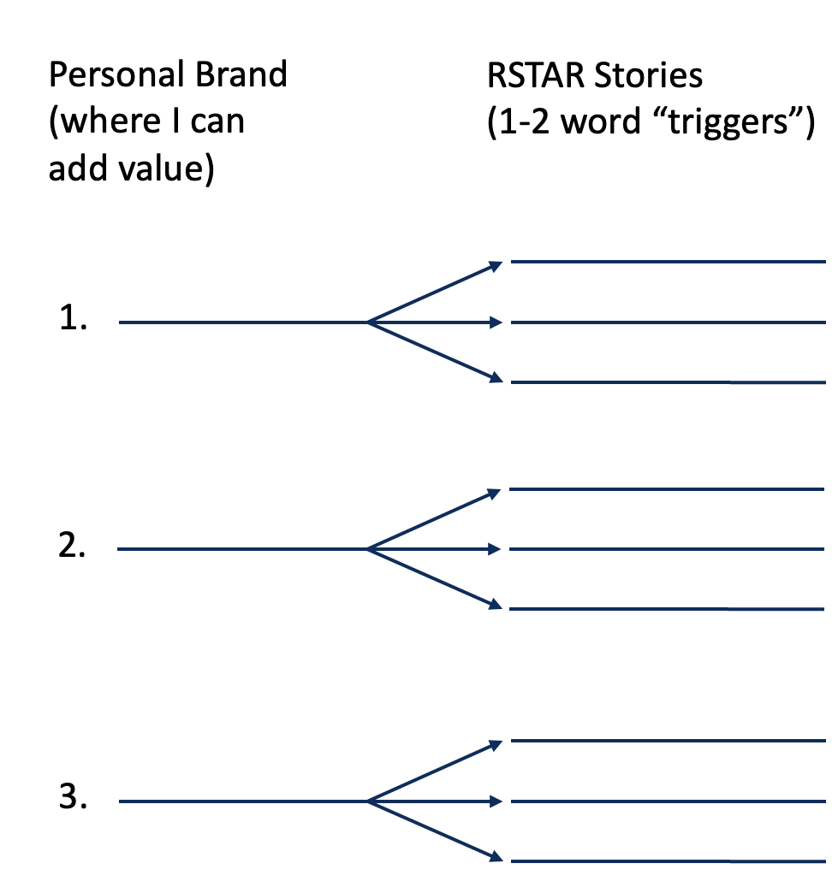
Exercise #3: Write “Triggers” for 9 RSTARs (9 minutes)

Slide 30
Personal Brand
(where I can
add value)
RSTAR Stories
(1-2 word “triggers”)
Give me an example of when you led a cross-functional team to achieve a significant result. | Tell me about an accomplishment you are most proud of. | What are your three greatest strengths? Or, Why should we hire you? | Tell me about a time you made a mistake and how you handled it. | Tell me about a difficult work situation and how you overcame it. | Describe how you improved a process that saved the company money and time.
1.
2.
3.
Questions for Company (ex.: Amazon):
Press release—2023, listed as Top 100 “Just” Companies, based on community contributions, labor and human rights, etc. What has stood out to you about Amazon’s contributions?
Amazon Leadership Principles: Earn Trust, deliver results, but particularly “learn and be curious” (my career). Once an employee how do you encourage Learn and be Curious?
What are the trends that will impact the company over the next 3-5 years? How is Amazon competing with Alibaba and Rakuten in the Asian markets?
What has been the biggest challenge you have enjoyed with your work at Amazon?

Slide 32
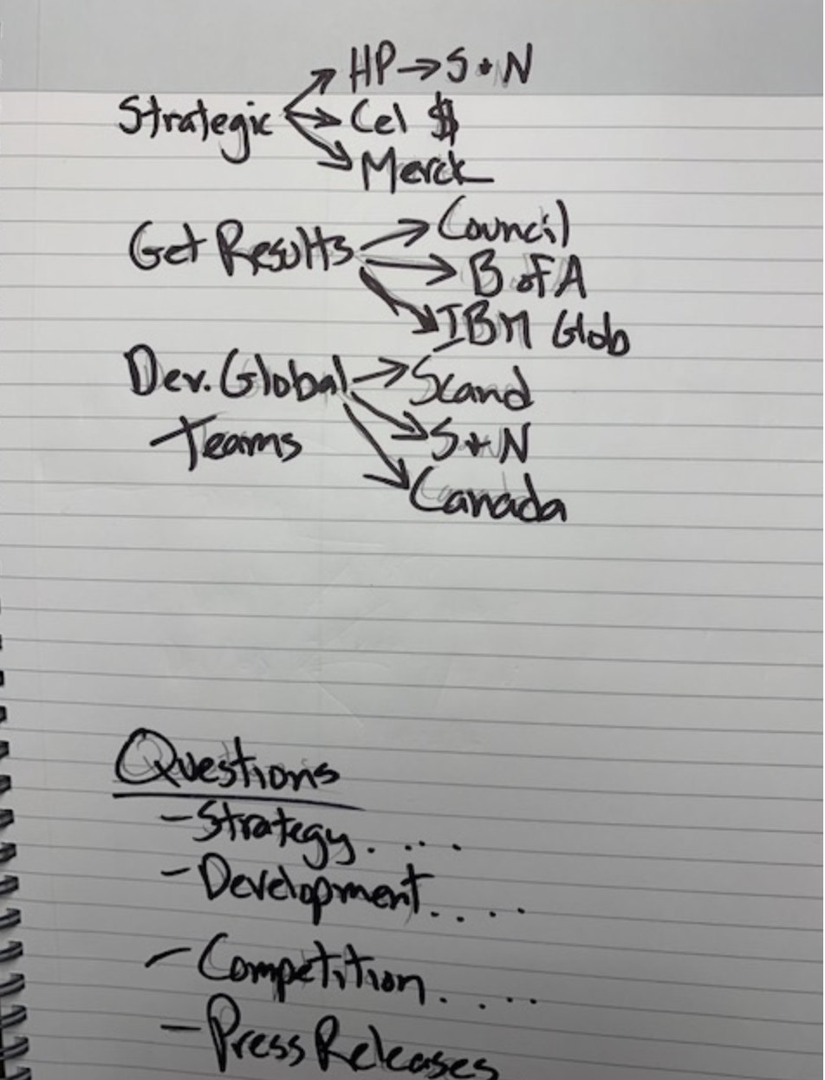

Slide 33
Questions?

