Slide 1




“
FEEDBACK
Phyllis Wagner
Principal & CEO
Show your spark! Express passion for what you do/did and for the company
Demonstrate solid EQ, show confidence NOT ARROGANCE and work to build a connection
NBMBA Review | Tool Beyond B-School | RSTAR Clarify Objectives | RSTAR Framework | Practice
Notes:
Meet Phyllis Wagner, Principal & CEO of Corporate Collaborations and Executive Search firm.
Prior to Corporate Collaborations, Phyllis was a Sr. Executive for 20+ years with P&G.
“Be mindful of how you are communicating.”
Regarding the TASK portion of the STAR story, “Demonstrate your ability to analyze the problem.”
Regarding the RESULT piece of your STAR story, “Define not only the result but the general outcome and be as data driven as possible.”

Slide 2
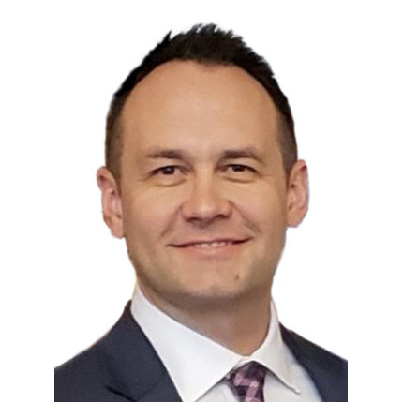

“
FEEDBACK
Adam Lancaster
Former Sr. Manager, Global Procurement
I REALLY like people to show that they're human...perhaps my favorite RSTAR story was during an interview with a Chicago Booth MBA intern candidate last summer...he let me know that he was pitching an idea to an executive and it fell flat on its face...he walked out of the room and paused...then said, "well $#*!...what do I do now?" And he went and figured out what to do next. I LOVED that he showed flaws, that he was passionate about what he was trying to achieve...didn't give up and that he overcame it.
Don't use stories where you didn’t take the lead in the action or results. Often, the interviewer will dig deeper in these RSTAR stories and learn that the person was just along for the ride.
Be a good story-teller! Nothing is worse than trying to stay engaged during a really boring, i.e., too wordy, too detailed, just not interesting story. Be passionate/energized about your story!
KEEP IT SHORT and allow for the interview to probe deeper...even ask the interview after the story, "I didn't want to go into too much detail; is there anything you wanted me to dig into further?"
NBMBA Review | Tool Beyond B-School | RSTAR Clarify Objectives | RSTAR Framework | Practice
Notes:
Meet Mr. Adam Lancaster, former Sr. Manager of Global Procurement at ADOBE (he helped with our Prof. Mock Interview experience for your orientation)
Referring to RSTAR stories he said, show that you’re human
DON”T use a story if you didn’t take the lead in the action or results.
Be a good story teller – be engaging, keep it interesting and be passionate about your story.
Keep it short!!

Slide 3
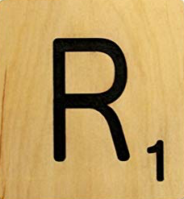



SUCCESS FRAMEWORK
ADD “R” to the Start!
RESULT
TASK
ACTION
SITUATION
RESULT
“RSTAR” Stories – make it MORE Powerful – LEAD WITH THE MOST POWERFUL PIECE!
Spend MUCH more time on ACTION and RESULTS and less on the SITUATION/TASK
STORYTELL – MAKE IT MEANINGFUL, BE ENGAGING, NOT BORING
USE EMOTION – CONFLICT/TENSION – RESOLUTION
AND DO IT IN 2 MINUTES OR LESS!
NBMBA Review | Tool Beyond B-School | RSTAR Clarify Objectives | RSTAR Framework | Practice
Notes:
After you have assessed culture fit, geographic fit, etc.
Begin the framework by:
Reviewing the job description – pay particular attention to the skills required – make a list.
Assess your own skills, your experience and preparation to contribute in the role as described.

Slide 4
“Past performance is indicative of future performance. Use this framework to document some of your R.S.T.A.R. stories – then translate this into a succinct response to “Tell me about a time when…”
NBMBA Review | Tool Beyond B-School | RSTAR Clarify Objectives | RSTAR Framework | Practice

Slide 5
PRACTICE, Practice & PRACTICE
“Tell me about a specific accomplishment you are most proud of”
“Tell me about a time you used data to influence an important stakeholder”
Now, Build a RSTAR Story to answer this!
NBMBA Review | Tool Beyond B-School | RSTAR Clarify Objectives | RSTAR Framework | Practice

Slide 7
Behavioral Interviewing
“
”
Methodology
Career Management Class September 18, 2023
Notes:
Welcome / Introduction

Slide 8

AGENDA
Practice
Success
Framework
Clarify
Objectives
Data & Feedback
Data & Feedback | Clarify Objectives | Success Framework | Practice
Notes:
Agenda for today:
Data & Feedback
Clarify Objectives
Success Framework
Practice

Slide 9



DATA – WHY IT MATTERS
“Behavioral Interviewing is considered by many to be the MOST effective type of interviewing technique.”
“R.S.T.A.R. framework is proven effective in understanding ‘targeted competencies’.”
Polled 1100 currently employed or actively looking for work – “RSTAR is the most used methodology”
“80% of turnover is due to bad hiring decisions…”
“Structured Behavioral Interviewing predicts future behavior – good or bad.”
NBMBA Review | Tool Beyond B-School | RSTAR Clarify Objectives | RSTAR Framework | Practice
Notes:
Many companies work very hard to get the interview right - It is very costly to hire the wrong person
MONEY MAGAZINE: Most organizations spend approx. 70% of their operating budget on workforce expenses
SHRM: Behavioral Interviewing is considered by many to be the MOST effective type of Interviewing Technique. - RSTAR framework is proven effective in understanding ‘targeted competencies”!
GLASSDOOR: polled 1100 adults who are either currently employed or actively looking for work “RSTAR is the most used methodology.”
HARVARD BUSINESS REVIEW: “80% of turnover is due to bad hiring decisions – Structured Behavioral Interviewing predicts future behavior – good or bad.”
STATS regarding the CANDIDATE EXPERIENCE:
LINKEDIN: GLOBAL TALENT TRENDS (5,000 talent professionals surveyed over 35 countries for behavioral data)
91% of report interviewing for ‘soft skills – 80% say soft skills are increasingly important to company success. “while hard skills may get a candidate’s foot in the door, it’s soft skills that ultimately open it.”
Soft skills being sought: 1. Creativity, 2. Persuasion, 3. Collaboration, 4. Adaptability, 5. Time Management
89% say bad hires typically lack soft skills‹

Slide 10

DATA
The most common ways to assess soft skills
Percentage of talent professionals who say their company uses the
following methods to assess soft skills
Behavioral questions
Situational questions RSTAR
Reading body language
Mini Case / Project work
Technology based assessments
75%
70%
60%
48%
22%
R.S.T.A.R. Method provides structure to Behavioral Interviews
NBMBA Review | Tool Beyond B-School | RSTAR Clarify Objectives | RSTAR Framework | Practice
Notes:
LinkedIn Report: The go-to assessment methods leveraged by hiring companies:
75% say their company uses Behavioral Interviewing to assess soft & hard skills
70% report using specific Situational Questions
60% say they train the interviewers to read body language
48% report their company is utilizing mini-case-based interviewing/project work to assess skills
22% report their company is using tech-based assessments to understand hard skills

Slide 11

UNDERSTAND THE OBJECTIVES for the EMPLOYER
Take the Bias Out of Interviews – “Get Beyond the Gut “
Clearly Identify Strengths/Competencies/Leadership Potential
Get to a More Objective Set of Facts
Assess the Hiring Risk
NBMBA Review | Tool Beyond B-School | RSTAR Clarify Objectives | RSTAR Framework | Practice
Notes:
In the context of what it takes to hire MBA level talent – it is vital that the interviewer/hiring manager gets it ‘RIGHT’!
Clarifying the objectives of the interviewer:
Take the bias out of interviews
Get to more objective set of facts
Learn what they really need to know – WHAT DO THEY REALLY NEED TO KNOW?

Slide 12


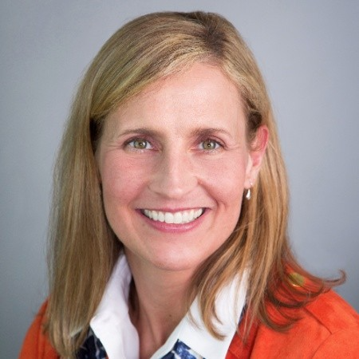

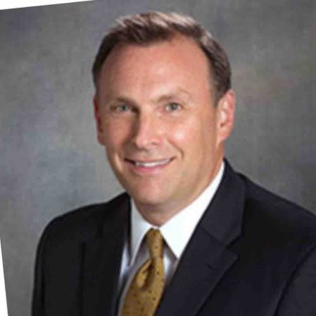
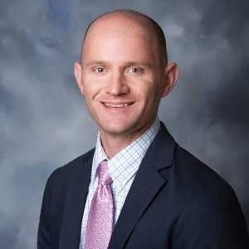

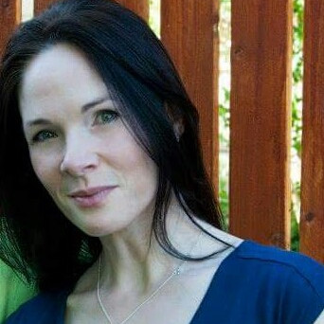
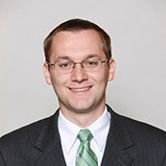
FEEDBACK
NBMBA Review | Tool Beyond B-School | RSTAR Clarify Objectives | RSTAR Framework | Practice
Notes:
I reached out to several professionals with a request for their insights & perspectives related to the framework of STAR Stories to answer Behavioral Interview questions.
All of these individuals have been on the front lines of interviewing, some for 20+ years.
The next slides will be TEXT HEAVY – but there valuable information shared.

Slide 13
Phyllis Wagner
Principal & CEO
Data & Feedback | Clarify Objectives | Success Framework | Practice
Notes:
Meet Phyllis Wagner, Principal & CEO of Corporate Collaborations and Executive Search firm.
Prior to Corporate Collaborations, Phyllis was a Sr. Executive for 20+ years with P&G.
“Be mindful of how you are communicating.”
Regarding the TASK portion of the STAR story, “Demonstrate your ability to analyze the problem.”
Regarding the RESULT piece of your STAR story, “Define not only the result but the general outcome and be as data driven as possible.”

Slide 14

“I think the RSTAR model is a great way to clearly showcase what opportunity/problem existed and allow a candidate to outline their ‘actions’ and ‘impact’.
If you’re hiring for the best talent, the interviewer wants to know that the candidate can achieve outcomes and results.
RSTAR stories should be brief and focused, allowing the interviewer to ask additional questions, but still need to have enough details that it’s a powerful example.
As candidates think through different RSTAR models from their own experiences they learn a lot about themselves, what helped them to be successful, and how to replicate it.
“
Cori Lindstrom
Vice President
Human Resources
Data & Feedback | Clarify Objectives | Success Framework | Practice
Notes:
Meet Cori Lindstrom, VP of Human Resources at Honeywell.
His first statement – “I think the STAR model is a great way to clearly showcase what opportunity/problem existed and allow a candidate to outline their ‘actions’ and ‘impact’.
Another valuable insight – “As candidates think through different STAR models from their own experiences they learn a lot about themselves, what helped them to be successful, and how to replicate it.

Slide 15

“You should have at least 5 good RSTAR stories that could be used across multiple question categories (e.g. leadership, strategic problem solving, cross-functional collaboration, improving processes, stakeholder involvement, etc. )”
Most important: The STAR of the RSTAR Story is YOU. Be sure the interviewer knows the impact YOU made.
Build your stories with transitions from R to S to T to A to R: It’s perfectly fine to say things like “The situation was…”, “My goal was to…”, “The actions I took were…”, and “As a result of my actions…”
Use a RSTAR story even when you think the answer to the question may not need it. Questions like “What is one of your weaknesses?” could use a RSTAR story answer.
“
Briant Giles
Brand Manager, Global Innovation
Data & Feedback | Clarify Objectives | Success Framework | Practice
Notes:
Meet Mr. Briant Giles, Brand Manager over Global Innovation with THE HERSHEY Company.
‘The STAR of the STAR story is YOU!”
“You should have at least 5 good STAR stories that could be used across multiple question categories.”

Slide 16
Adam Lancaster
Sr. Manager Global Procurement
“Be a good story-teller! Nothing is worse than trying to stay engaged during a really boring, i.e., too wordy, too detailed, just not interesting story. Be passionate about your story!”
Don't use stories where you didn't have the lead in the action or results. Often, we dig deeper in these STAR stories and learn that the person was just along for the ride.
KEEP IT SHORT and allow for the interview to probe deeper...even ask the interview after the story, "I didn't want to go into too much detail; is there anything you wanted me to dig into further?”
Only share a RSTAR story if that's what's being asked for.
Data & Feedback | Clarify Objectives | Success Framework | Practice
Notes:
Meet Mr. Adam Lancaster, Sr. Manager of Global Procurement at ADOBE
Referring to STAR stories he said, “This is something I think about ALL THE TIME!”
Show you are human
Be a good story teller
Keep it short
Only share a STAR story if that is what is being asked for…these stories get boring…

Slide 17

“Be concise: No more than 2-minute answers”
Spend only 10% on Results (like a headline of a story with a good “hook”), 10% to describe on the Situation and Task, and the 60% of the time on 'Actions.” Finally, end with 20% of the time on 'Results’ with some additional comments of what you learned.
Results frequently have more than one impact on the business. For example: “As a result of these actions I took, sales grew by 15% and consumer experience improved by 12%. In addition, I was asked to train the rest of the team on how to replicate this on other businesses.”
Results can also include what you've learned, for example: "As a result, we saw 15% lift in sales and along the way, I learned the value of keeping an entrepreneurial mindset when confronting big company problems".
Matt Durham
Brand Manager, Innovation – Tylenol Cold, Sudafed, Visine, Lactaid, Imodium & Pepcid Brands
“
Data & Feedback | Clarify Objectives | Success Framework | Practice
Notes:
This is Matt Durham, Brand Manager of Innovation for Tylenol Cold, Sudafed, Visine, Lactaid, Imodium & Pepcid Brands at Johnson & Johnson.
“Be concise.
Suggests, “60% of the time on ‘ACTIONS and 30% of the time on RESULTS
Don’t treat your RESULTS as an after thought!

Slide 18
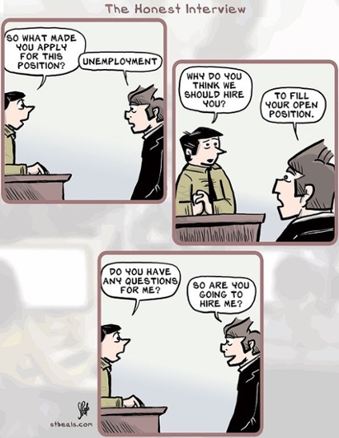
PRACTICE
Data & Feedback | Clarify Objectives | Success Framework | Practice
Notes:
Ideally the STAR story framework is intended to help you be successful in an interview – it can also help in general conversations related to work - peer-to-peer, perhaps as you are working to solve a problem.

Slide 19
PRACTICE, Practice & PRACTICE
THANK YOU
Data & Feedback | Clarify Objectives | Success Framework | Practice

